Slide 1

Cam-stylus
Minor project
2020

Slide 2
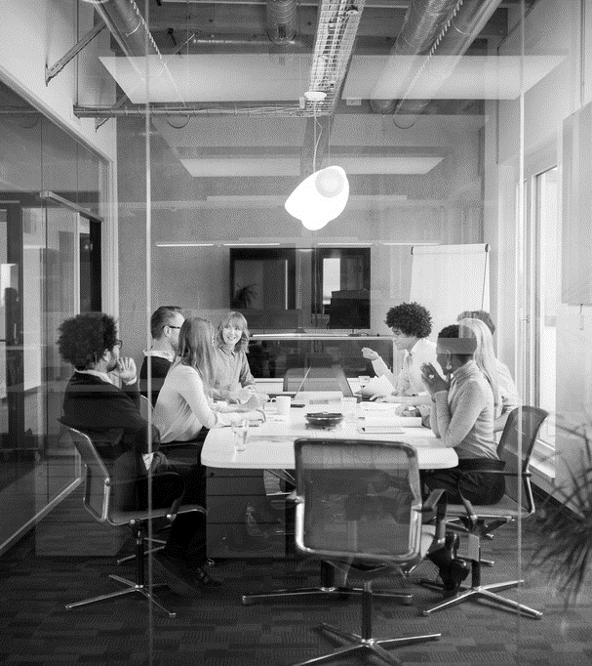
Agenda
Exploring the possibility of computer vision is both interesting from a scientific point of view and something that could be beneficial to virtual graphics industry .

Slide 3
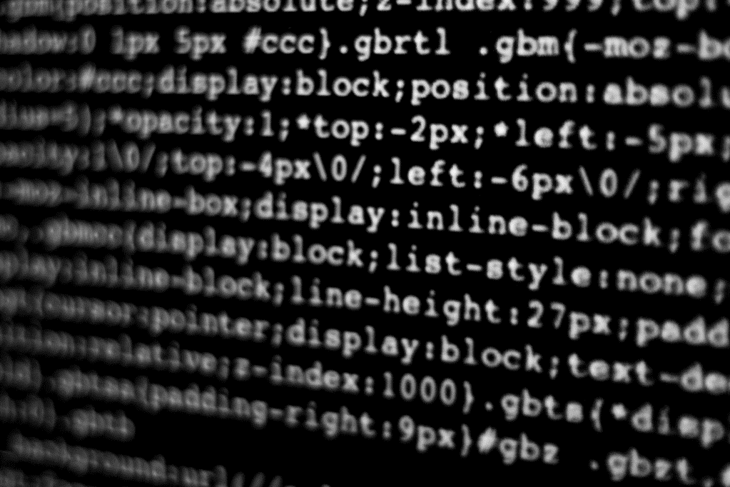
Motivation
Computer vision is a science of teaching computers to see. With the state of the art algorithms, this technology is behind many applications like self-driving cars, image recognition, medical diagnosis etc. The best part of computer vision is these techniques are used for detecting cancerous cells which helps in saving lives by adding filters to your face to entertain you. Similarly, it has a wide variety of interesting and useful applications. In this project, we will do hands-on implementation on how to create a virtual painting app without touching the keyboard, and just by drawing on-air that will be displayed on the screen.

Slide 4
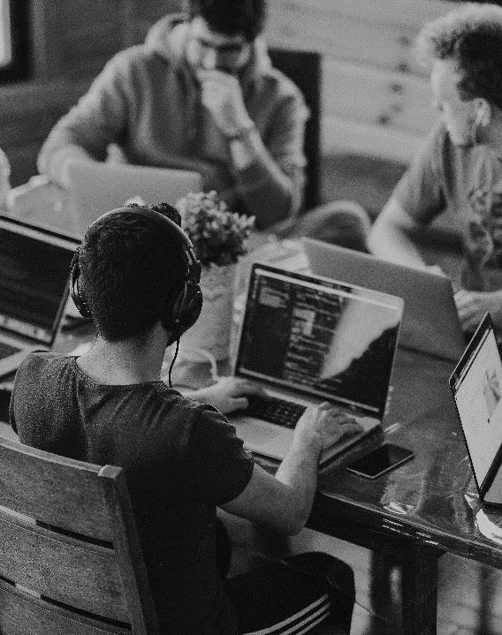
INTRODUCTION
Approach
In this project, We will be using the computer vision techniques of OpenCV to build this project. . The preferred language is Python due to its exhaustive libraries. Here Color Detection and tracking are used in order to achieve the objective. The color marker is detected and a mask is produced. It includes the further steps of morphological operations on the mask produced which are Erosion and Dilation. To perform video tracking, an algorithm analyzes sequential video frames and outputs the movement of targets between the frames.

Slide 5
Technology used
Python libraries to implement machine learning models-pandas, Numpy, scikit learn, opencv, jupyter notebook, collections, matplotlib

Slide 6

What’s next
LOOKING AHEAD
OpenCV is the most popular open source computer vision library in the world. It implements over 2500 optimized algorithms, works on all major operating systems, is available in multiple languages and is free for commercial use. This talk will primarily provide a technical update on OpenCV: What’s new in OpenCV 4.0? What is the Graph API? Why are we so excited about the Deep Neural Network (DNN) module in OpenCV? (Short answer: It is one of the fastest inference engines on the CPU.) We will also briefly share info on the new Open Source Vision Foundation (OSVF), and on OpenCV’s sister organizations, CARLA and Open3D, and some of the initiatives planned by these organizations.

Slide 7
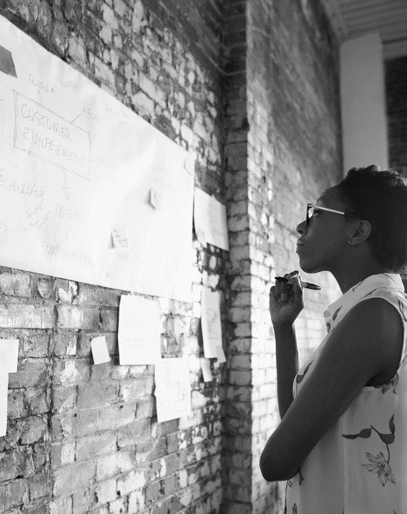
SUMMARY
This project is relevant to Virtual Developers and Artificial Intelligence. OpenCV is at work in robotics systems—picking let‐tuce, recognizing items on conveyor belts, helping self-driving cars see, flying quadrotors, doing tracking and mapping in virtual and augmented reality systems, helping unload trucks and pallets in distribution centers, and more—and is built into the Robotics Operating System (ROS). It is used in applications that promote mine safety, prevent swimming pool drownings, process Google Maps and streetview imagery, and implement Google X robotics .

Slide 8


THANK YOU
MENTOR
MANSI GYANCHANDANI MA’AM
MAIL
camstylus@gmail.com
MENTEE
SHASHANK SINGH
ANKIT KUMAR
KANISHK SINGH
VIKAS SAO

